Slide 1
File IO

Slide 2
File
The data is stored on machine in form of a file.
File is a collection of related data.
Stored on some location, on the disk.
We can perform read and write operations on these files.
Two actions can be performed:
Data transfer between console and program.
Data transfer between program and disk file.

Slide 3
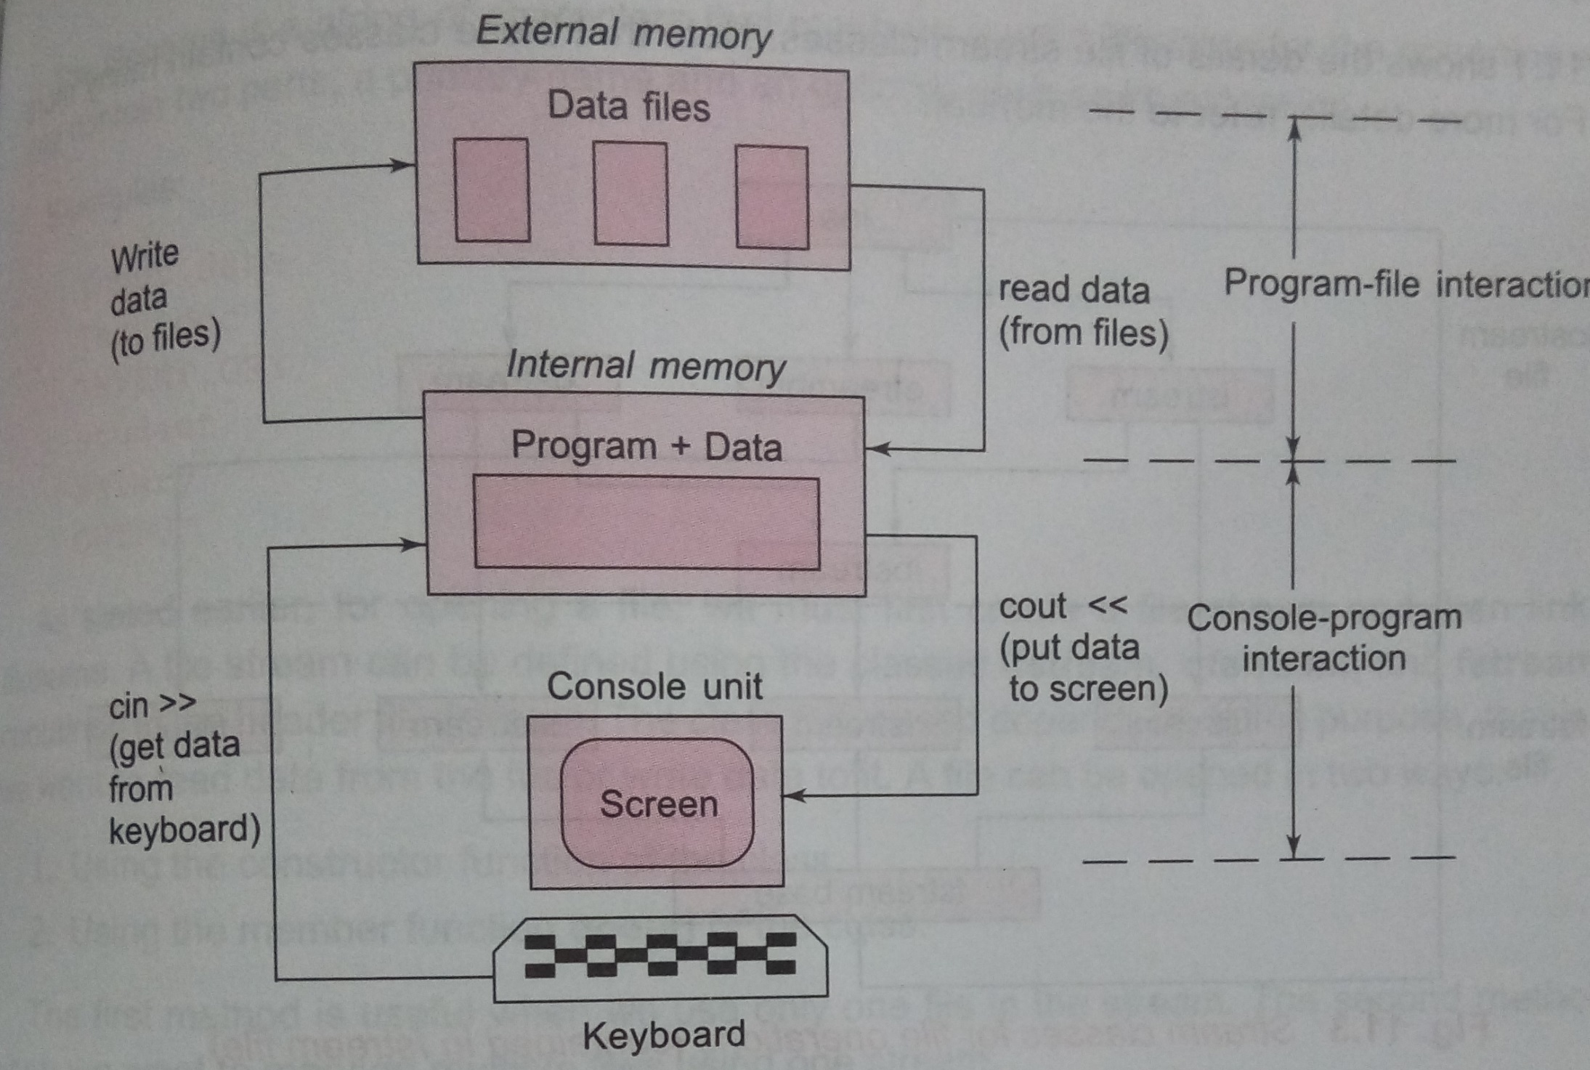

Slide 4
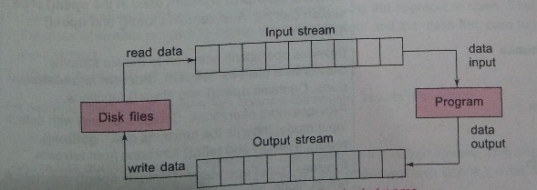

Slide 5
Classes
Fstreambase
ifstream
ofstream
fstream
filebuf
fstreambase
ifstream
ofstream
filebuf
fstream

Slide 6
File Operations
1: Open File
2: Read Write
3: Close File

Slide 7
1: Open File
There two methods:
A) Using Constructor of the class
ofstream outf(“name.ext”)
ifstream inf(“name.ext”)
B) Using open () function.
File_Stream_class Object;
Object.open(“Filename.ext”)

Slide 8
Methods for read and write
Read Data:
We can use any variable to hold data of the file and print them using >>.
Use getline () function.
Write Data:
We can use any variable to hold data and save it using << function.

Slide 9
Working with Single File (Example)
Write Data to file:
ofstream outf(“test”);
Char name[30];
int age;
Cout<<“Enter name : ”;
Cin>> name;
Outf<<name<<“\n”;
Cout<<“Enter age: ”;
Cin>> age;
Outf<<age<<“\n”;
Outf.close();

Slide 10
Read Data From File:
ifstream inf(“test”);
inf>> name;
cout<<“Name = ”<< name <<“\n”;
inf>> age;
cout<<“Age= ”<< age<<“\n”;
inf.close();

Slide 11
End of File
While (file object){
Fileobject.getline([],size);
Cout<< []
}
OR
If(fileobject.eof () !=0){
exit(1);
}

Slide 12
Modes
app
ate
Binary
In
Nocreate
Noreplace
Out
trunc

Slide 13
Character I/O
Put
get

Slide 14
int main()
{
fstream file;
char str[100];
int len;
cout<<"Enter any string data: " ;
cin>> str;
len=strlen(str);
file.open ("textFile.txt", ios::out);
for(int i=0; i<len;i++){
file.put(str[i]) ; }
file.close();
file.open ("textFile.txt",ios::in );
char ch;
cout<<"\n \n Reading data from the file\n\n";
while(file){
file.get(ch);
cout<<ch;
}
file.close();
}

Slide 15
fstream file;
char str[100];
int len;
Cout<<“Enter any string data: ”;
Cin>> str;
Len=strlen(str);
File.open (“textFile”, ios::out | ios::in );
For(int i=0; i<len;i++){
file.put(str[i]) ; }
File.seekg(0);
Char ch;
Cout<<“\n \n Reading data from the file\n\n”);
While(file){
file.get(ch);
cout<<ch;
}
File.close(); }

Slide 16
Read() and write()
Save data in binary form.
Syntax:
Infile.read( ( char*) & c, sizeof( c ) );
outfile.write( ( char*) & c, sizeof( c ) );

Slide 17
Example
Main(){
float stdw[5]={52.5,60.7,38.2,59.4,75.6};
fstream file(“test”, ios::out);
File.write( ( char*) &stdw, sizeof(stdw));
File.close();
for(int i=0; i<4;i++)
stdw[i]=0;
File.open (“test”, ios::in);
Float std[4];
File.read((char*) &std, sizeof(std));
For(int i=0; i<5;i++){
cout<<std[i]<<endl; }
File.close();
}

Slide 18
Read / Write an Object to File
class student{
private:
string name;
int age;
float gpa;
public:
setdata(string n, int a, float g){
name=n;
age=a;
gpa=g; }
getdata(){
cout<< "\n Name = " << name;
cout<< "\n Age = " << age;
cout<< "\n GPA = " << gpa;
}};

Slide 19
int main()
{
student std[3];
fstream file;
file.open("std.dat", ios::out);
cout<< "\n Saving data for three students";
std[0].setdata("Ali",20,3.2);
file.write( ( char*) &std[0], sizeof(std[0]));
std[1].setdata("Babar",21,2.9);
file.write( ( char*) &std[1], sizeof(std[1]));
std[2].setdata("kamran",21,2.8);
file.write( ( char*) &std[2], sizeof(std[2]));
file.close();
cout<< "\n Data Saved";
getch();

Slide 20
cout<< "\n\n Reading data for three students";
file.open("std.dat", ios::in);
student view[3];
for(int i=0; i<3;i++){
file.read((char*) &view[i], sizeof(view[i]));
view[i].getdata();
cout<<"\n\n";
}
file.close();
return 0;
}

Slide 21
Command Line Arguments
Main( int argc, char * argv[])
Where :
Argc = argument counter.
Argv= argument value.
E.g Example:
C:\> hello world cpp
Argv[0] -> hello ………… command/filename/program name
Argv[1] -> world ……….. parameter
Argv[2] -> cpp …………… parameter

Slide 22
Print command
int main(int argc, char *argv[])
{
char temp[100];
fstream file1;
file1.open(argv[1], ios::in);
while(file1){
file1.getline(temp,100);
cout<<temp;
}
file1.close();
return 0;
}

Slide 23
File pointer
In C++ we have a get pointer and a put pointer.
get for getting (i.e. reading) data from a file
Put for putting(i.e. writing) data on the file respectively.
Functions :
Seekg
Seekp
Tellg
Tellp

Slide 24
seekg() is used to move the get pointer to a desired location with respect to a reference point.
Syntax: file_pointer.seekg (number of bytes ,Reference point);
seekg (streampos pos);
Example: fin.seekg(10,ios::beg);

Slide 25
tellg() is used to know where the get pointer is in a file.
Syntax: file_pointer.tellg();
Example: int posn = fin.tellg();

Slide 26
seekp() is used to move the put pointer to a desired location with respect to a reference point.
Syntax: file_pointer.seekp(number of bytes ,Reference point);
seekp (streampos pos);
Example: fout.seekp(10,ios::beg);

Slide 27
tellp() is used to know where the put pointer is in a file.
Syntax: file_pointer.tellp();
Example: int posn=fout.tellp();
The reference points are:
ios::beg – from beginning of file
ios::end – from end of file
ios::cur – from current position in the file.
In seekg() and seekp() if we put – sign in front of number of bytes then we can move backwards.

Slide 28
Example
int main(){
fstream myFile("test.txt", ios::in | ios::out | ios::trunc);
// Add the characters "Hello World" to the file
myFile << "Hello World";
// Seek to 6 characters from the beginning of the file
myFile.seekg(6, ios::beg);
// Read the next 5 characters from the file into a buffer
char A[6];
myFile.read(A, 5);
// End the buffer with a null terminating character
A[5] = 0;
// Output the contents read from the file and close it
cout << buffer << endl;
myFile.close();
}

Slide 29
Using file pointer to read no. of records
file.seekp(0,ios::end);
int end=file.tellp();
cout<<"\n \n Total No. of records in file: "<< end / sizeof (view[0]);

Slide 30
Quiz
1- Stream in a __________ of _________
2-syntax of read( ) function.
3. Create an object of fstream and open file in binary and read mode.
4. In command line argument first argument is __________ and second is ___________.

